Slide 1
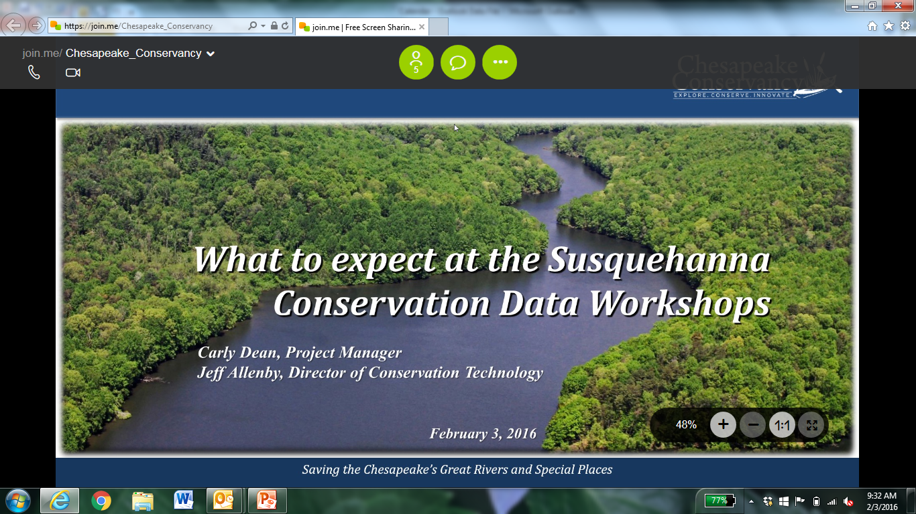

Slide 2
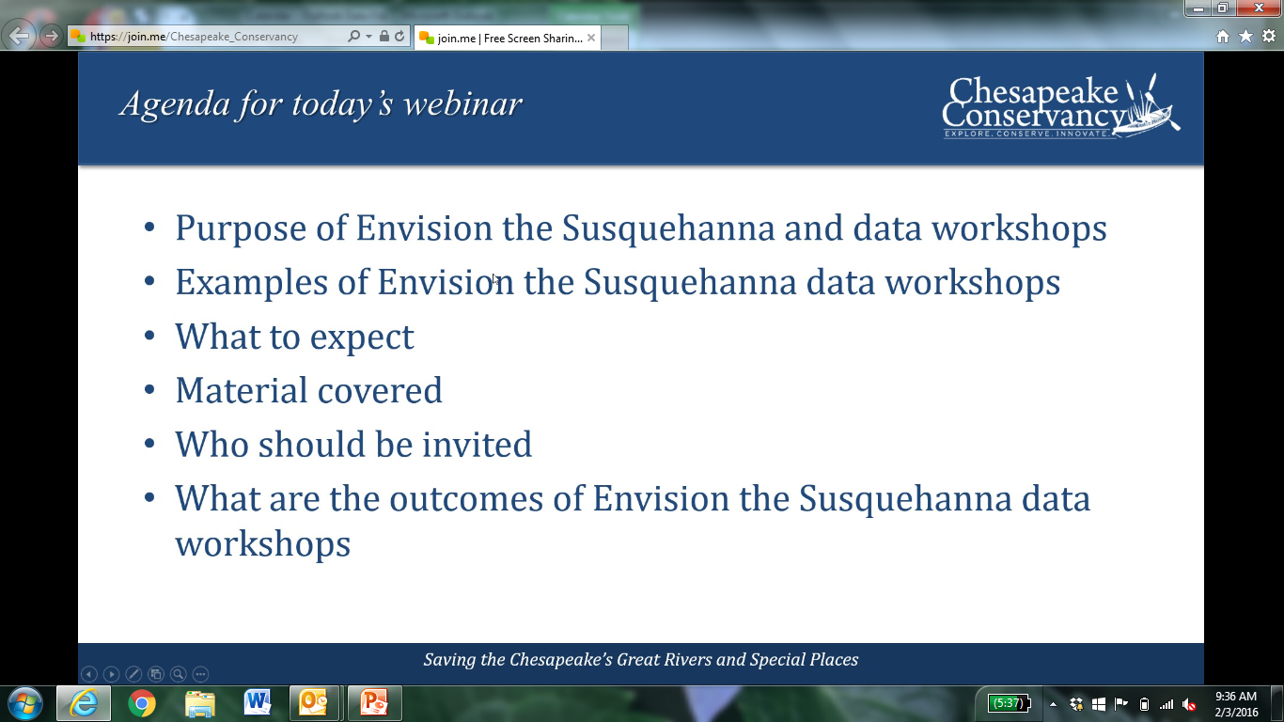
Purpose of call

Slide 3
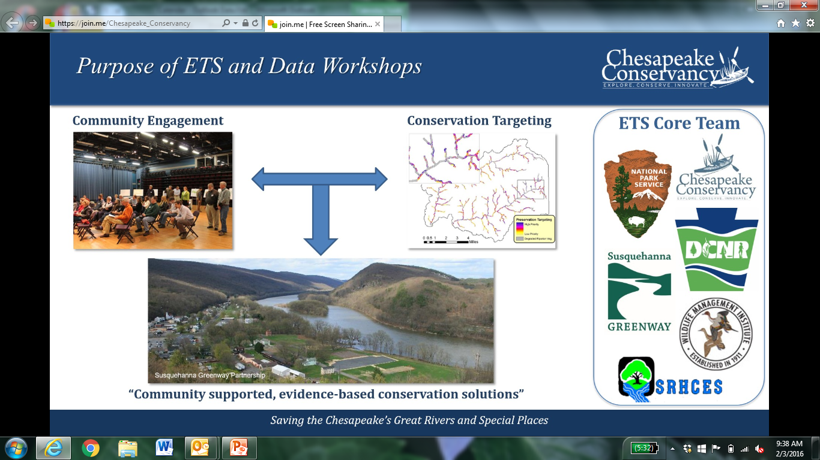
Envision the Chesapeake

Slide 4
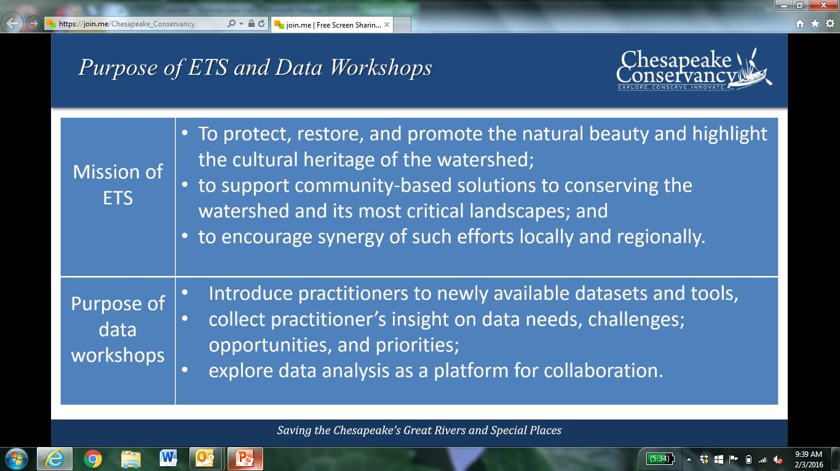
Chesapeake Conservancy funded to do data workshops with local partners

Slide 5
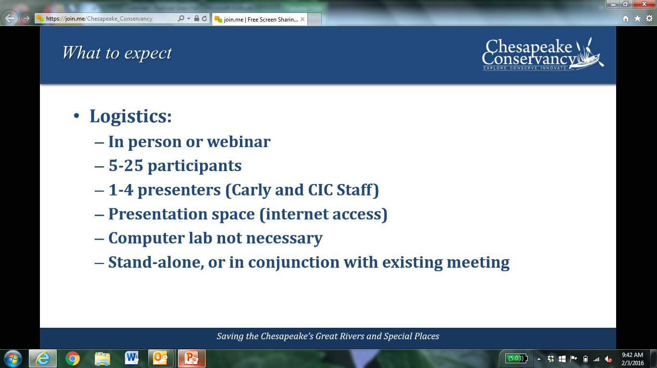
Data tools to help in identifying highest value landscapes, parcels, and areas for restoration, protection or engagement actions

Slide 6
Data and tools

Slide 7
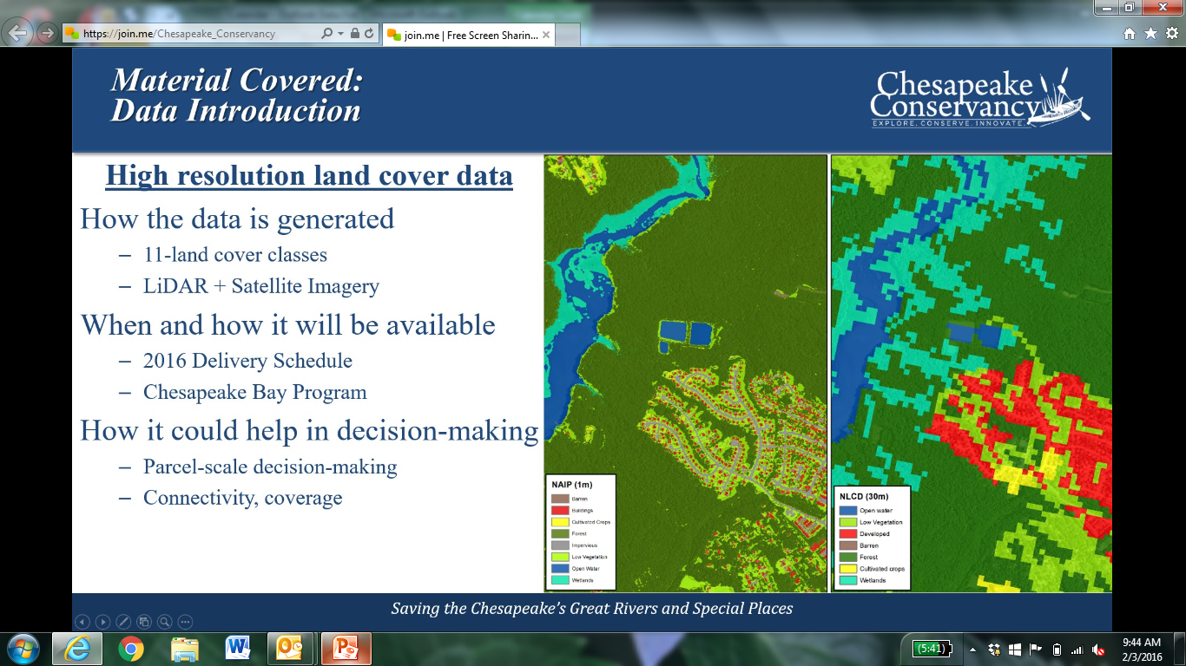
Chesapeake Conservancy is generating high resolution (1km) land cover datasets for all counties that touch the Susquehanna River. (Ready May 2016)

Slide 8
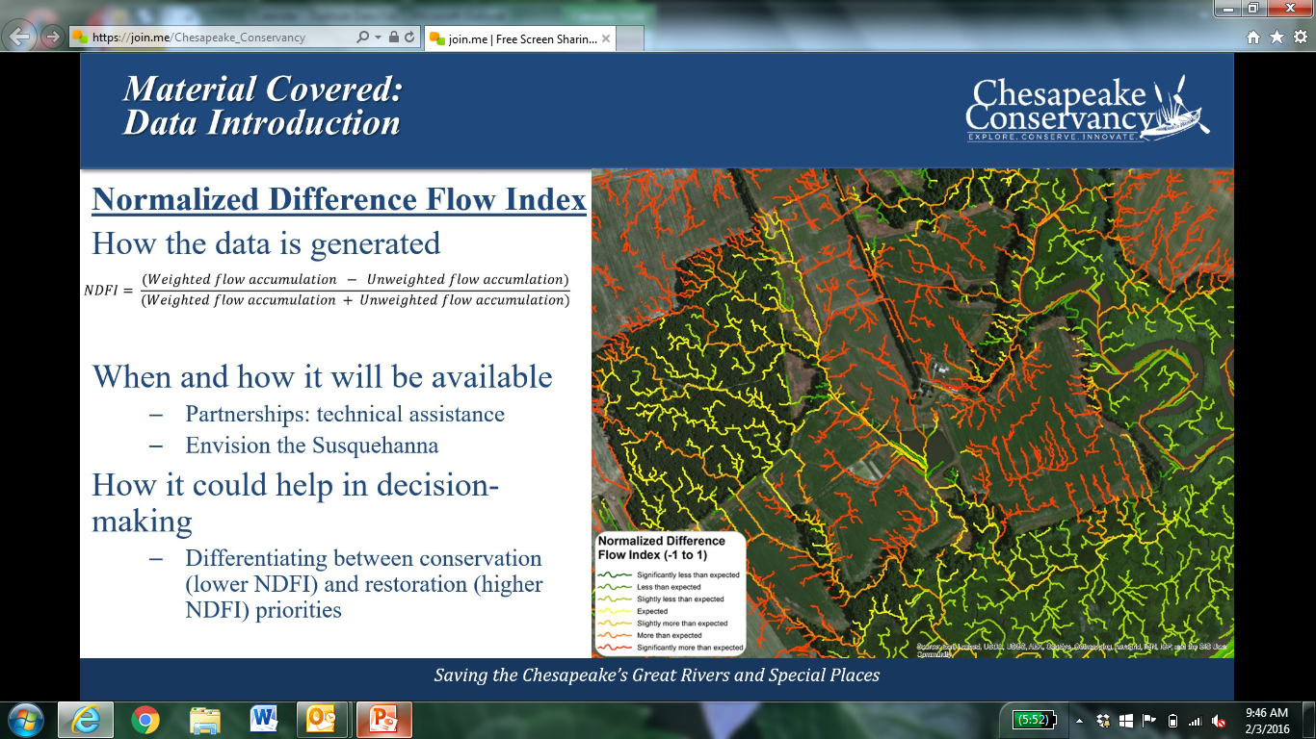
Normalized flow data is available for PA and MD. Currently processing flow data for the entire basin.

Slide 9
Re. flow data
USGS is working with the Conservancy to create information on “hydrologically enforced elevation models” to address things like culverts and bridges. Approach involves use of LiDAR data.
They are now doing some flow accumulation modelling for parts of the watershed. Willing to try to get funding with partners to expand this in to areas of interest. TNC seems interested in pursuing.

Slide 10
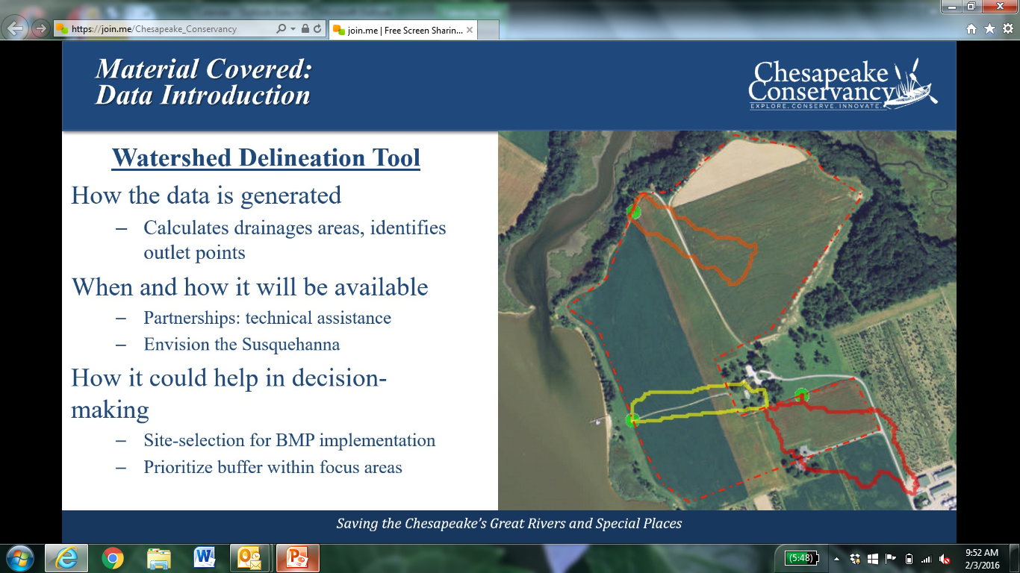
Can delineate microcatchments on a parcel scale. Use: working with individual landowners. Web-based. Also accessible via smartphones from the field. Working with Conservation Districts.

Slide 11
Re. prior slide
Tools to help others identify the best places to put their efforts and resources.
Elevation is fine enough to pick up ditches on properties.
Ties in to some models used by NFWF and others: nutrient and sediment reduction modeling
Working to automate features of this tool, to support calculations of impacts for non-technical practitioners (e.g., estimates required in funding applications)

Slide 12
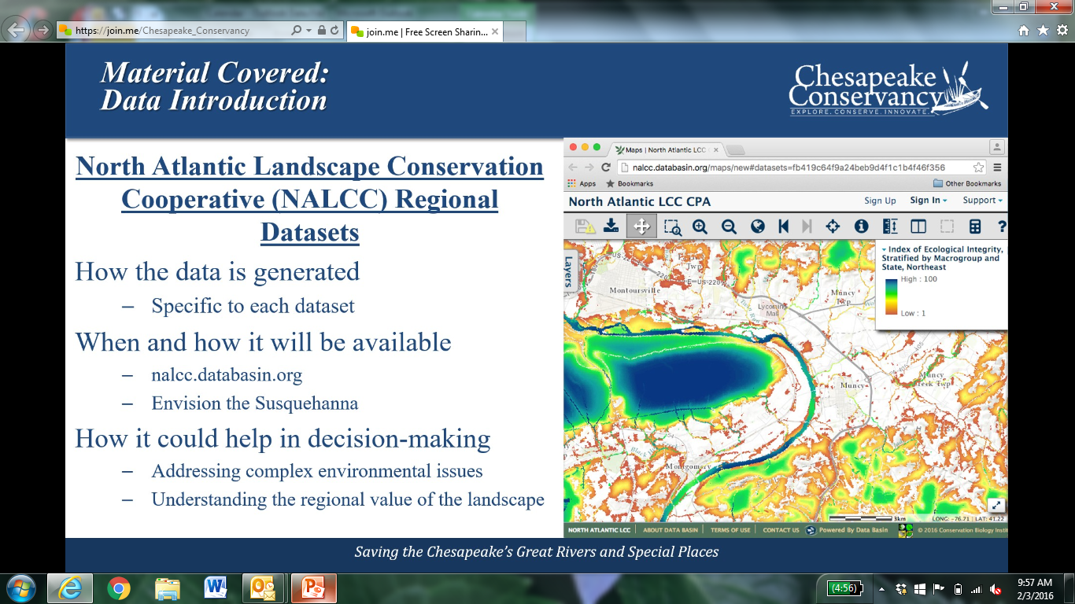
Databasin resources

Slide 13
Have been working with NALCC for three years
  Habitat connectivity
  Climate resilience
  Etc.
Recommending using these datasets to build a stronger, richer case for the environmental benefits of work in a targeted area
Participating in RCOA effort

Slide 14
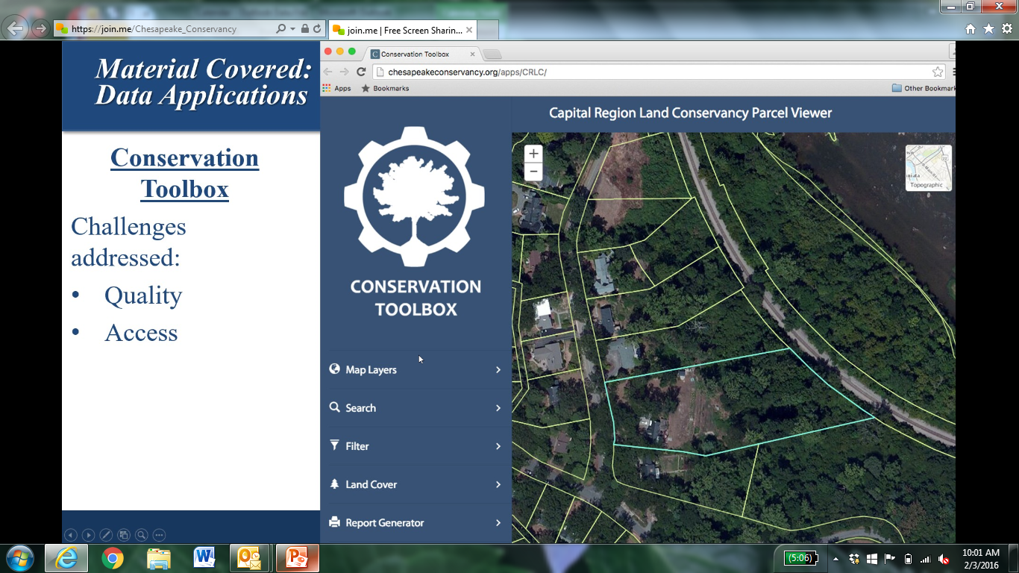

Slide 15
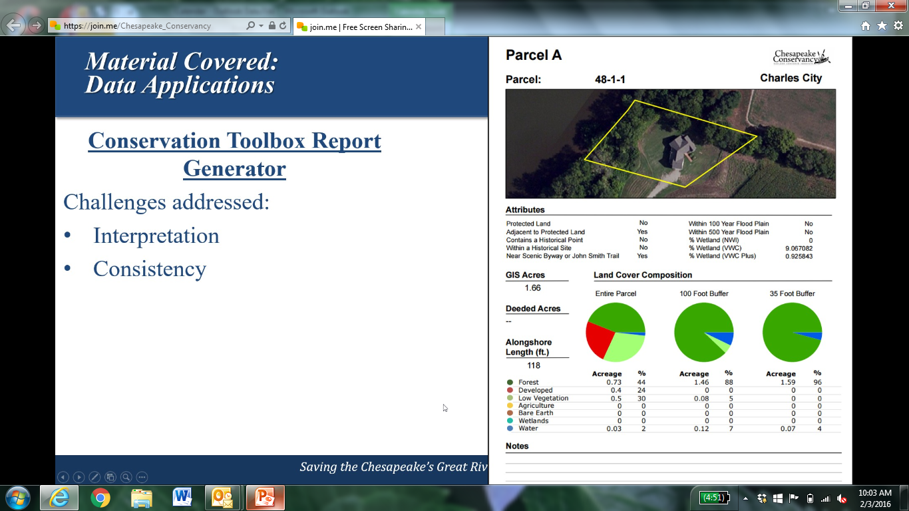
Custom reports generator

Slide 16
About prior slide
Working with York County Planning Commission in application of this tool, and driving grant applicants to use it in their funding requests
Bay Program has compiled parcel data from all counties that have it. There are data sharing restrictions on some, and gaps overall. PA does not offer free access to parcel data.

Slide 17
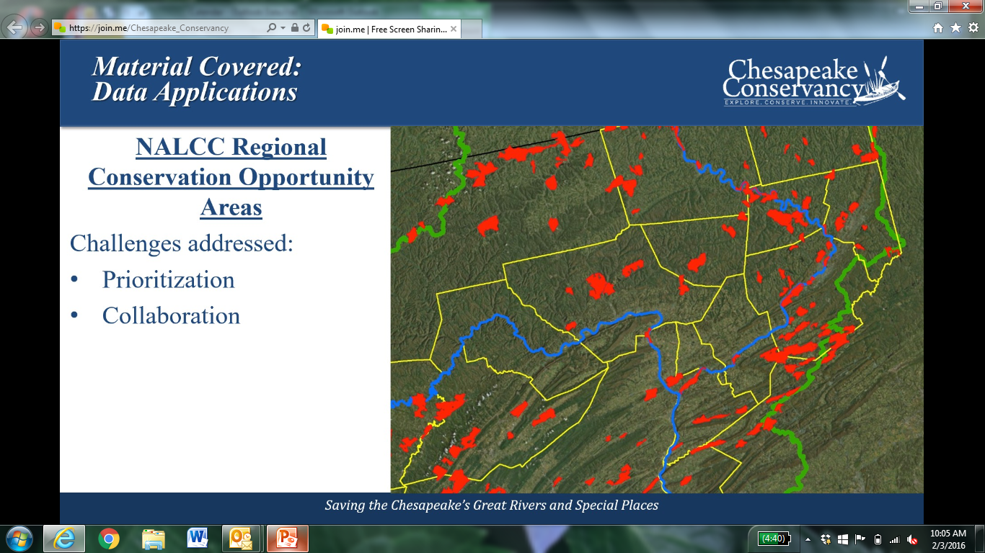
NALCC discussion: tools and partnerships

Slide 18
Chesapeake Cons. Participating in RCOA and doing analysis at HUC12 level and looking at road-bounded blocks as the units of analysis. Will be building the prioritization tool.

Slide 19
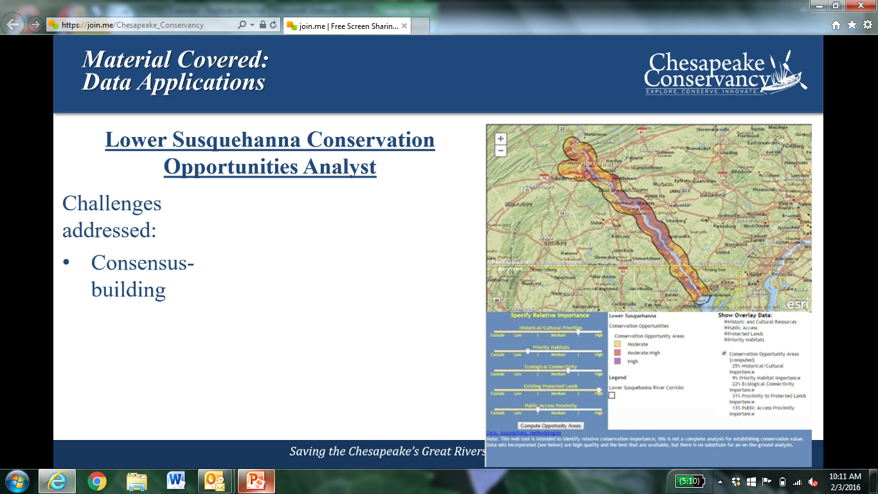
Opportunities Analyst Tool

Slide 20
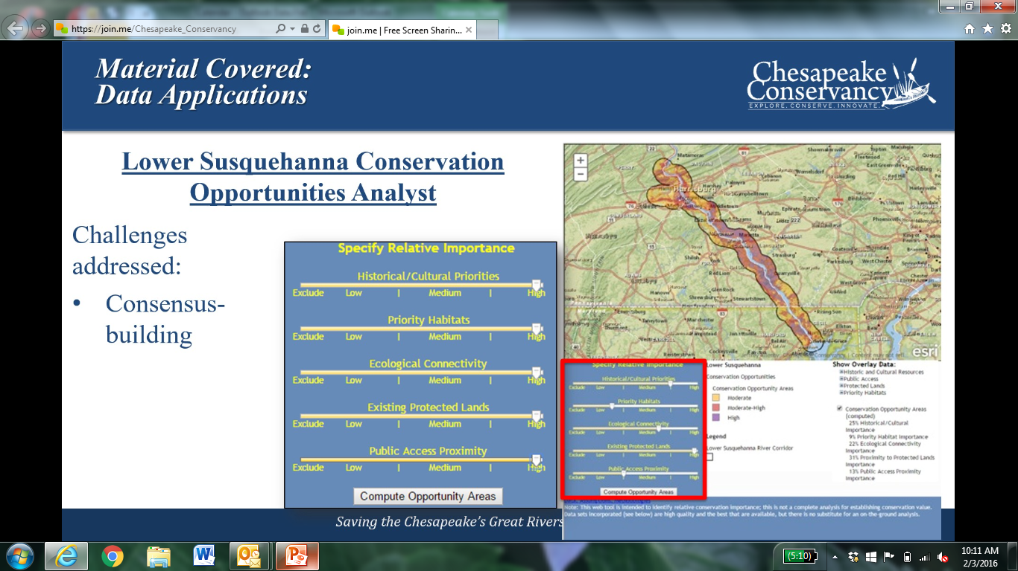
Allows users to input relative weights on attributes when doing prioritization. Provides immediate analyses.

Slide 21
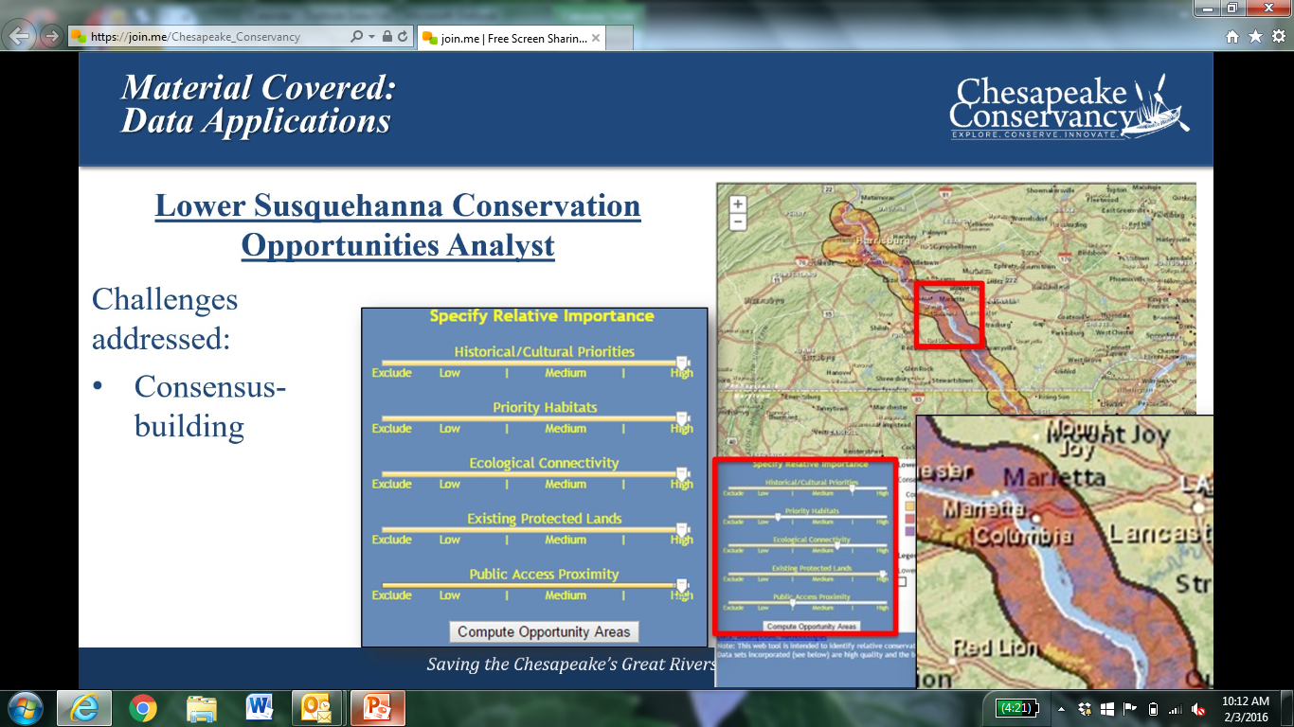
Limited geographic scope at present; Working to expand to the entire Susquehanna basin

Slide 22
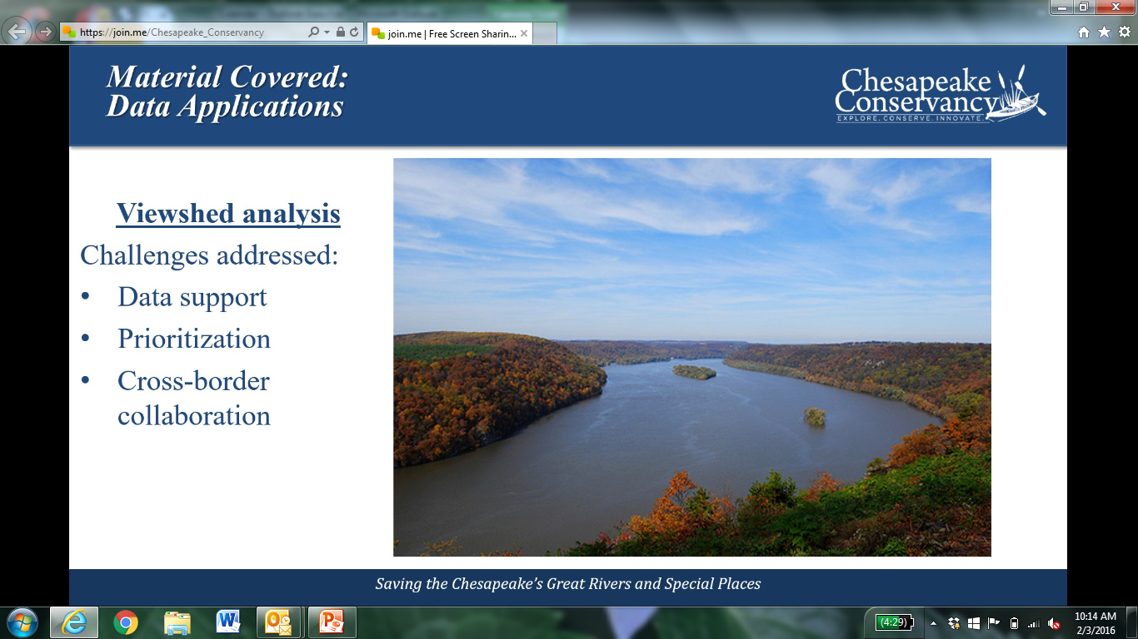
Using high res data, LiDAR data for this

Slide 23
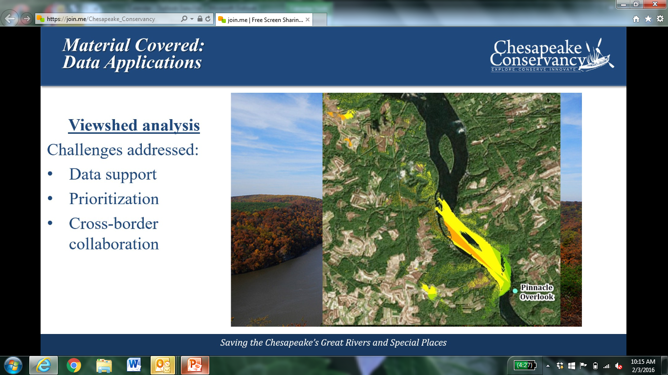
Case study in Lower Susquehanna

Slide 24
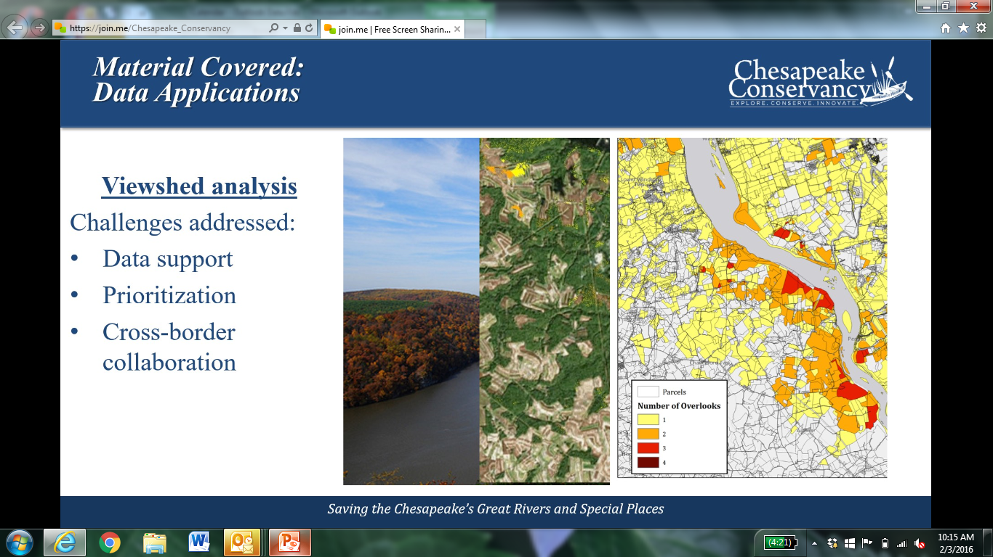
Additional detail Lower Susquehanna

Slide 25

Quantified how many scenic overlooks a parcel is visible from

Slide 26
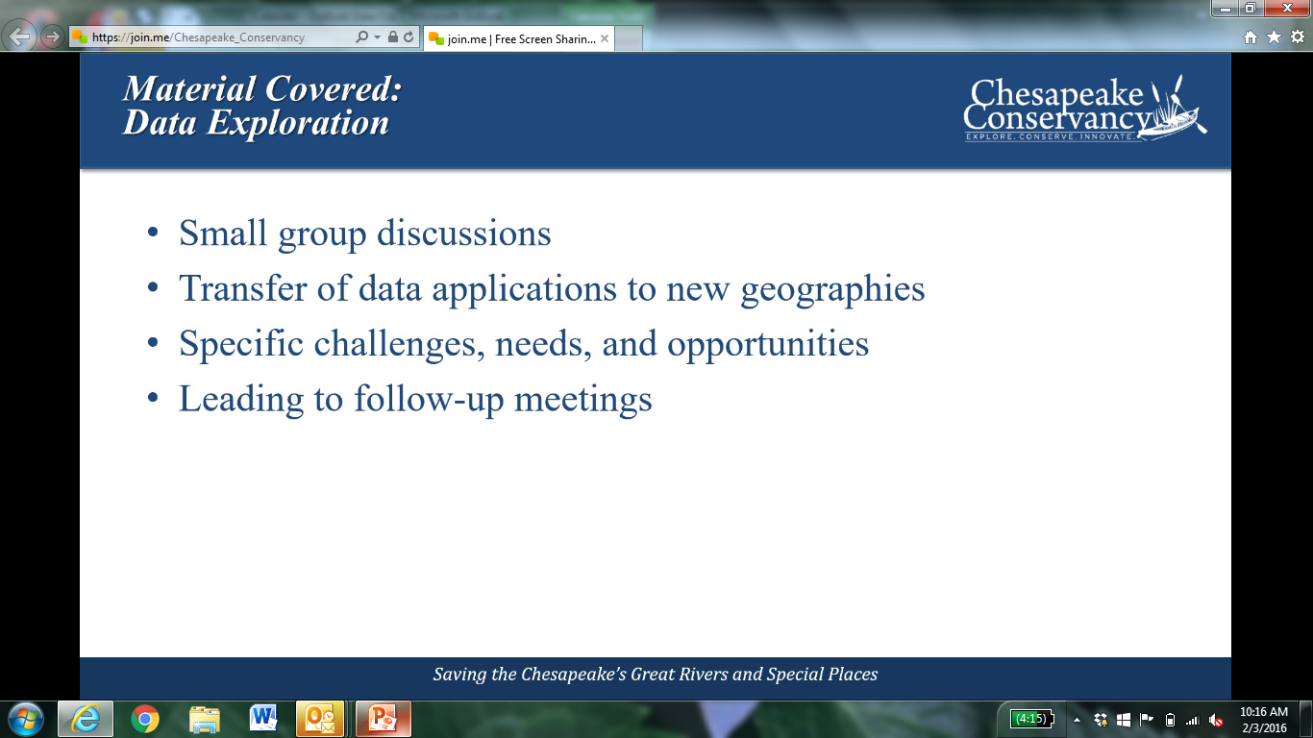
Fine resolution data requires greater capabilities for data storage & processing. Conservancy’s tools provide that functionality to the conservation community

Slide 27
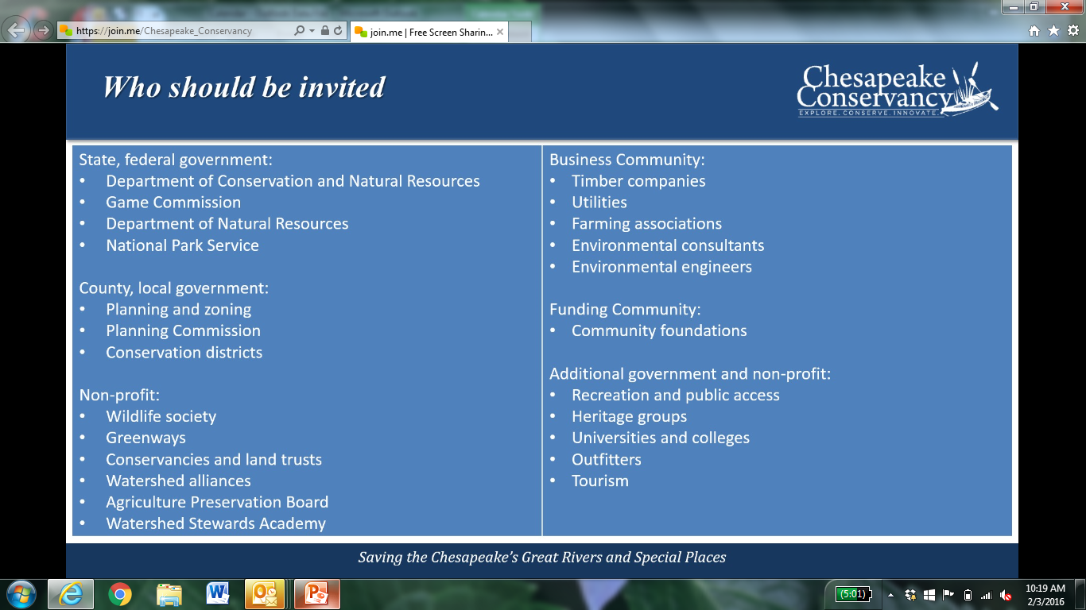
Left = types of organizations they have had at past workshops; Right = target groups they’d like to engage in the future. Trying to reach the non-GIS person

Slide 28
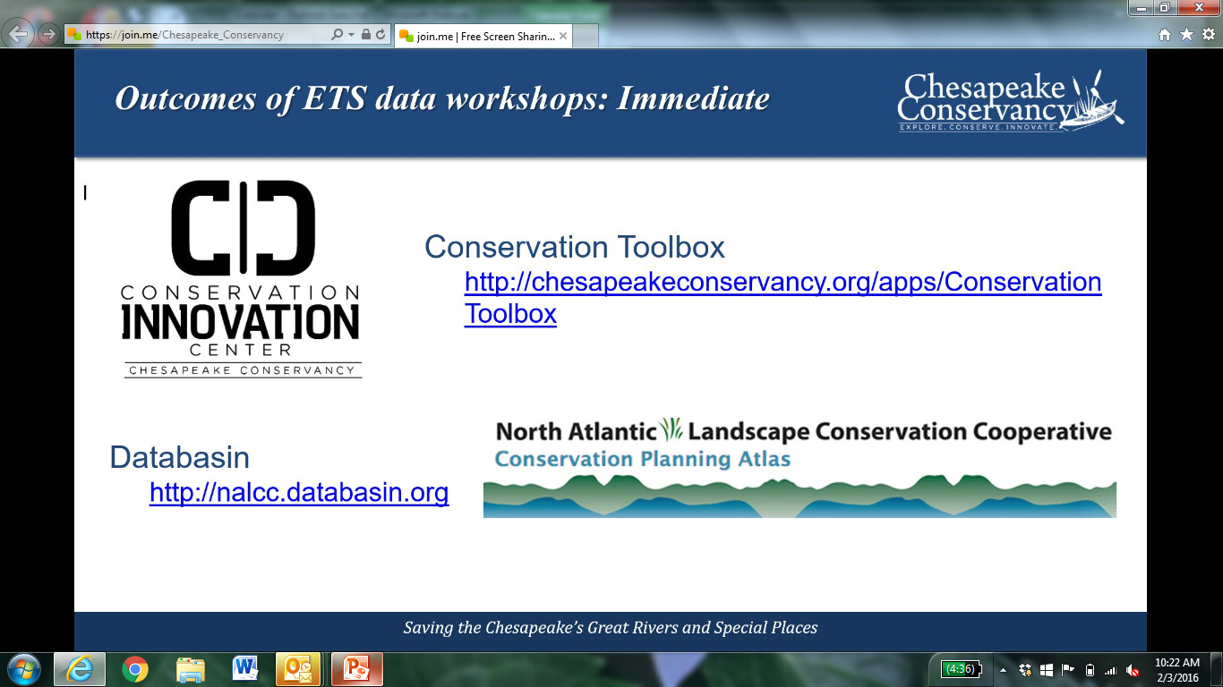

Slide 29
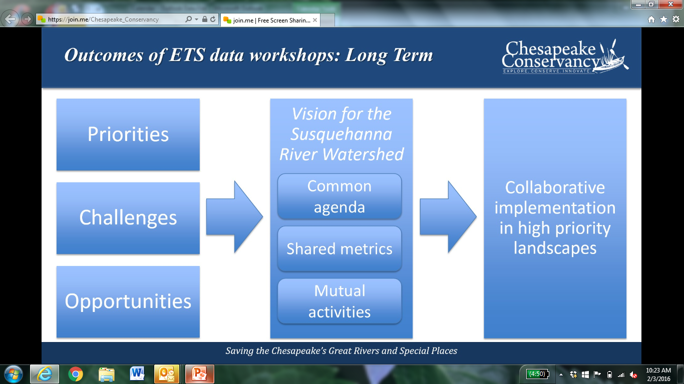

Slide 30
